Slide 1
Credit Card Approval Prediction

Slide 2
Introduction
In recent times there’s been an increase in the application for credit cards. Many of which have been wrongly rejected and accepted.
Analyzing these applications is such a mundane, error prone and time-consuming tasks hence the use of machine learning to develop credit card prediction solutions.

Slide 3
Objective
Build a machine learning model to predict if an applicant is a 'good' or 'bad' client.

Slide 4
Is bad credit approval a problem?
Let’s examine this scenario:
Taking a sample from any database (let’s say 150,000 customers). If we find that 6.6% of customers were seriously delinquent in payment for the past 3 years.
This could lead to potential loss of millions of dollars
This could lead to loss of customers
It could potentially lead the business to bankruptcy
Hence the need for Credit card approval solution

Slide 5
Business Benefits
Accurate prediction. Takes into account the client credit history over a long period as well other factors such as employment status, income and properties.
Automated processes. Once your client data is entered into the system it is automatically processes and returned with a prediction.
Faster processing. It delivers decisions quickier that previous methods
Reduction in fraudulent cases (False positives)

Slide 6
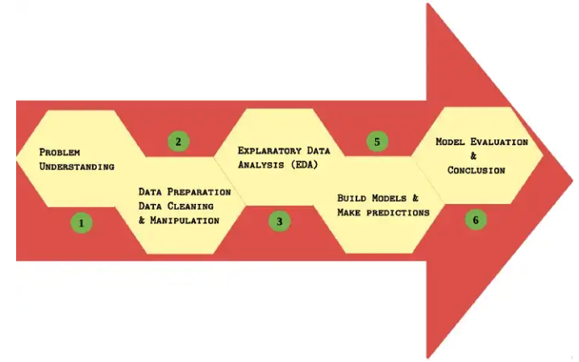
Credit Approval Prediction Building
There are 6 main steps involved in building this model

Slide 7
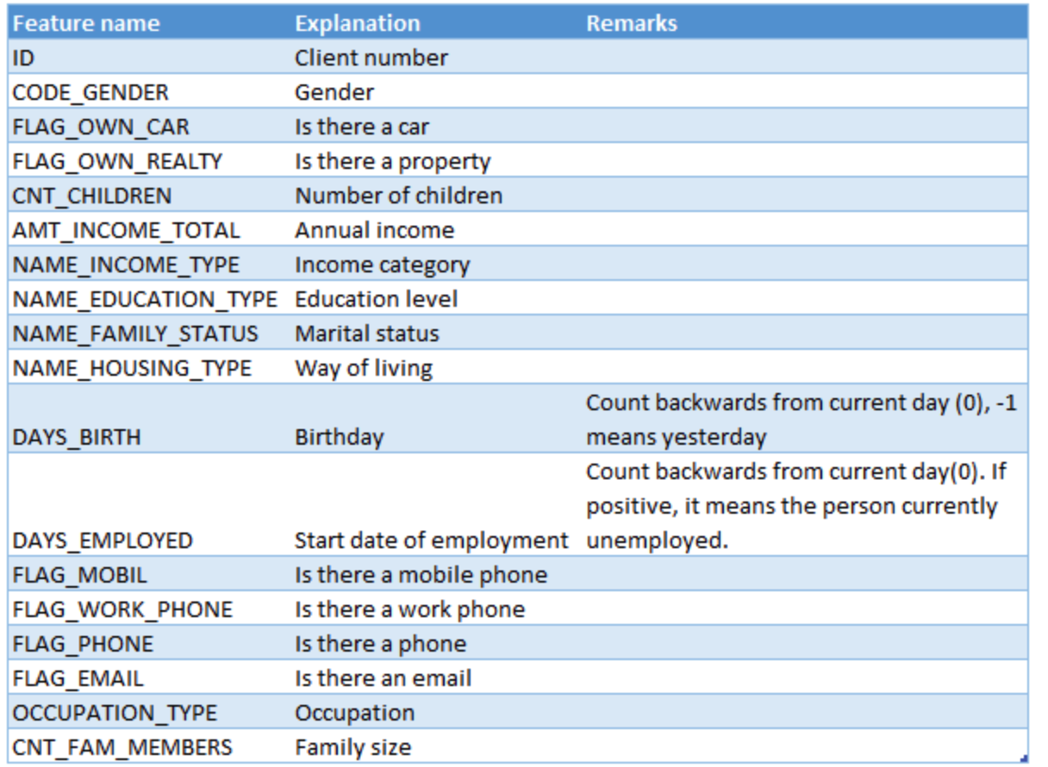
Step 2: Data Preparation and Cleaning
The data is a combination of an application information ( done either online or physically) (438557 in total) used for assessing the creditworthiness of the customer and a monthly credit card account status information (1048575 in total).

Slide 8
Step 2: Data Preparation and Cleaning
Key observation from the data:
FLAG_MOBIL feature contains only one unique value
The data contains duplicate values
Only feature had missing values (OCCUPATION_TYPE)
No missing values in the credit record information data

Slide 9
Step 2: Data Preparation and Cleaning
Feature Engineering Step
Labelencoded categorical variable
Fill missing values
Standardized numerical features
Added more features(age, employed) from existing (DAYS_EMPLOYED, DAYS_BIRTH)
Dropped useful features
Handled imbalanced dataset using SMOTE technique
Changed data type of multiple features

Slide 10
Step 3: EDA
Key Observations from the date via EDA
There are twice as much female applicant as male
More male applicants have car
More female applicants have vehicle
More female are granted credit card compared to male. It can also be observed that it contains more female
Married and Single people have better chance of getting credit card that Widows and Seperated people
Student and State servant are less likely to get credit card
People with house have the highest chances of getting credit card

Slide 11
Thank you

